Slide 1
Computer vision
Zeel B Patel
Computer vision is an interdisciplinary scientific field that deals with how computers can gain high-level understanding from digital images or videos. From the perspective of engineering, it seeks to understand and automate tasks that the human visual system can do.^{[1][2][3]}

Slide 2
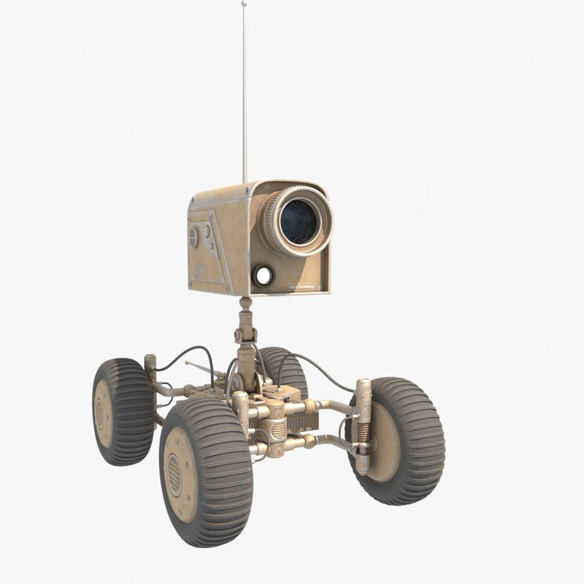
Motivation
An agent that can see can predict the future

Slide 3
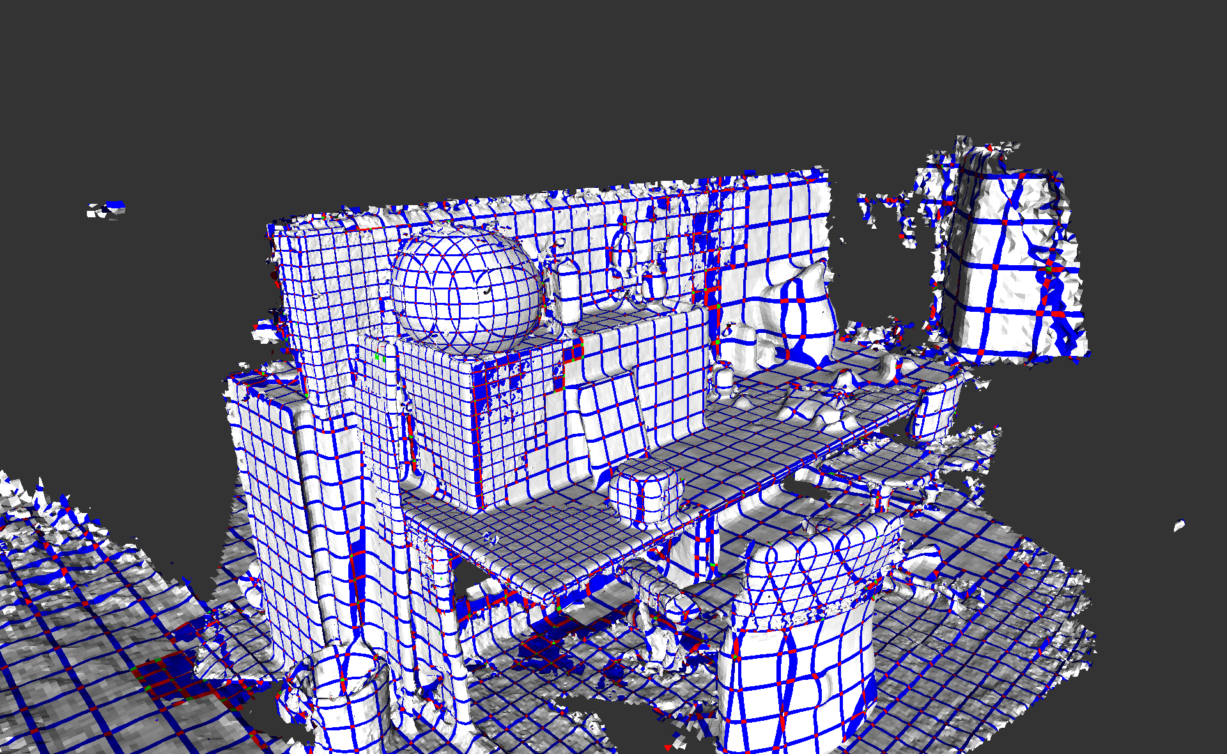
Two core problems in Computer vision
Reconstruction

Slide 4
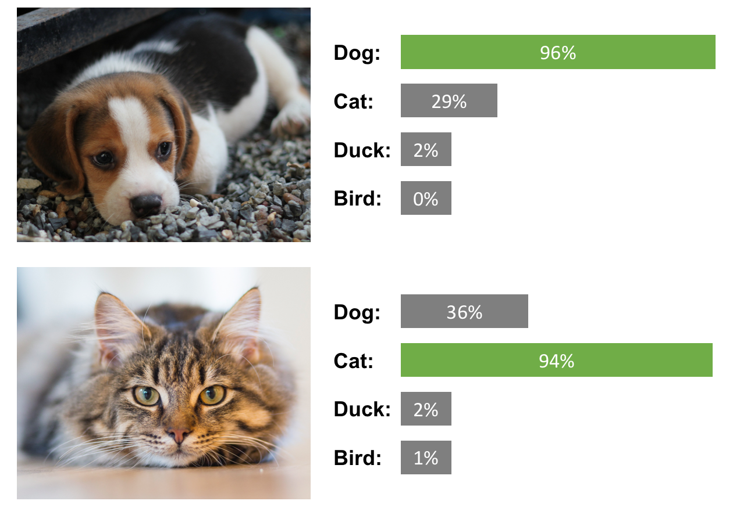
Two core problems in Computer vision
2. Recognition

Slide 5
Image formation

Slide 6
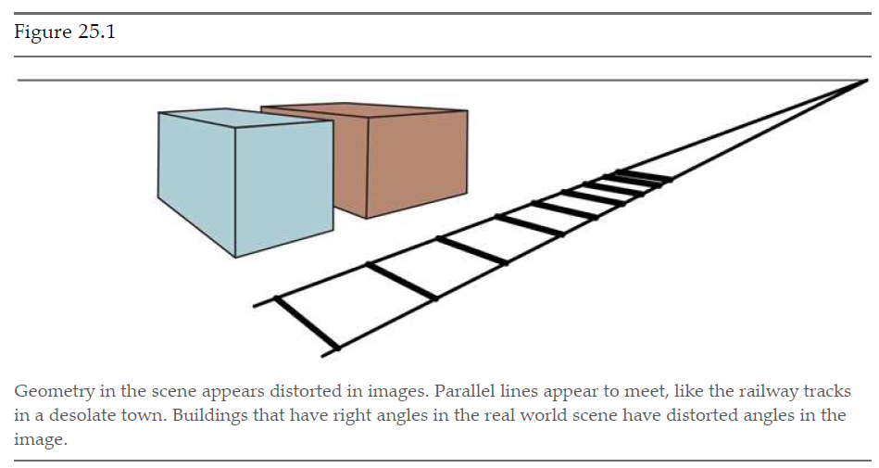
Image formation
Foreshortening

Slide 7
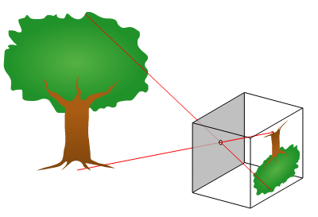
Pinhole camera
Aperture
Focal length

Slide 8
Problems with pinhole camera
Small hole - less light - darker image - focused image
❌ ❌ ✔️
Large hole - more light - brighter image - defocused image
✔️ ✔️ ❌

Slide 9
Lens camera
Large hole - more light - brighter image - focused image
✔️ ✔️ ✔️

Slide 10
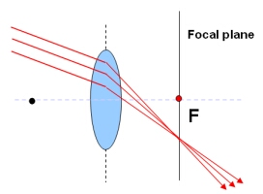
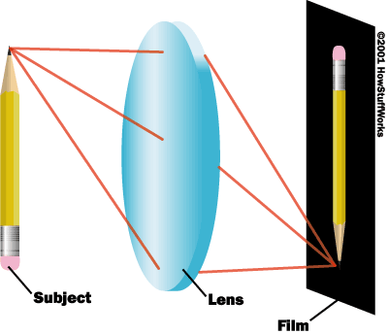
Lens camera
How to focus on a different point?

Slide 11
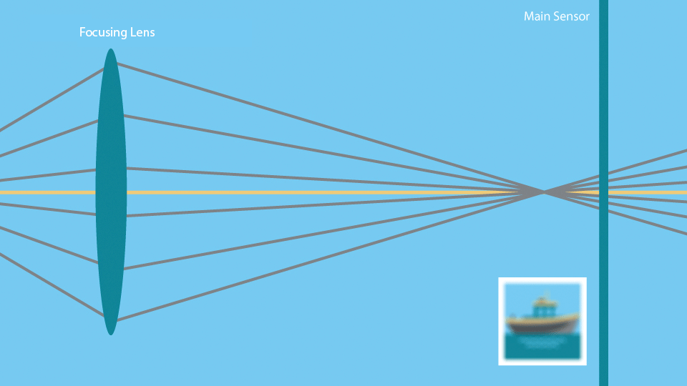

Slide 12
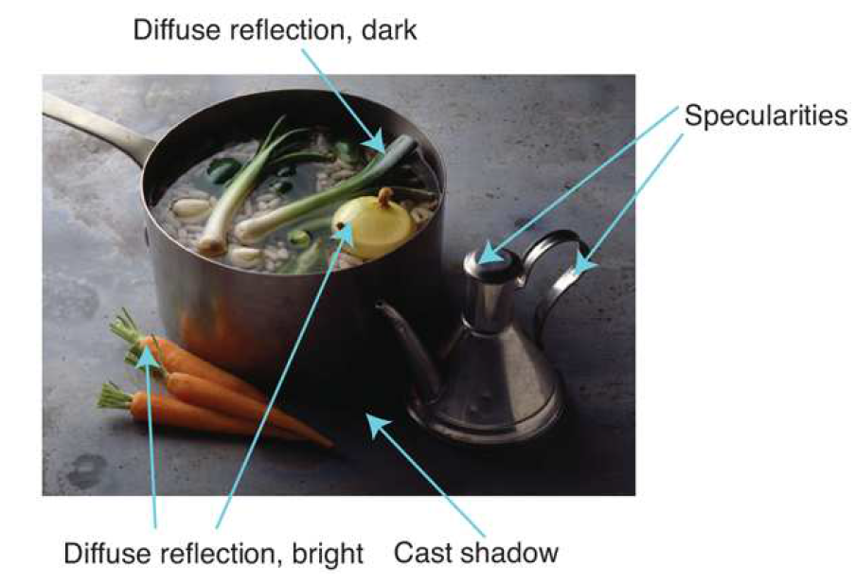
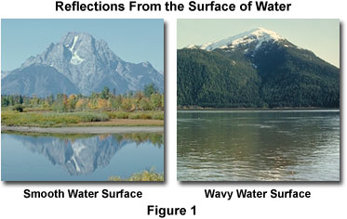
Illumination effects: Light and shading
Specularity Diffusion

Slide 13
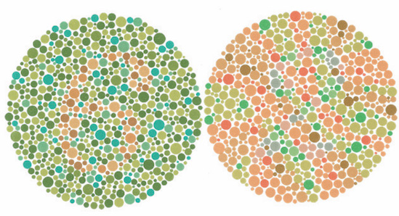
Color
Animals have vision receptors in range 1 to 6
Human eye have 3 receptors
Most vision systems use 3 base colors RGB or CMY
(principle of trichromacy)

Slide 14
Simple image features

Slide 15
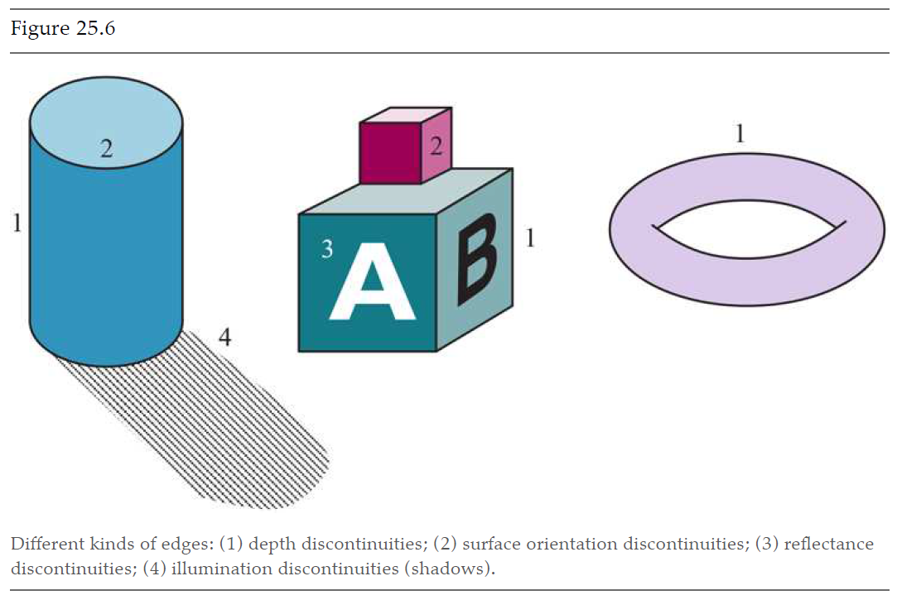
Edges

Slide 16
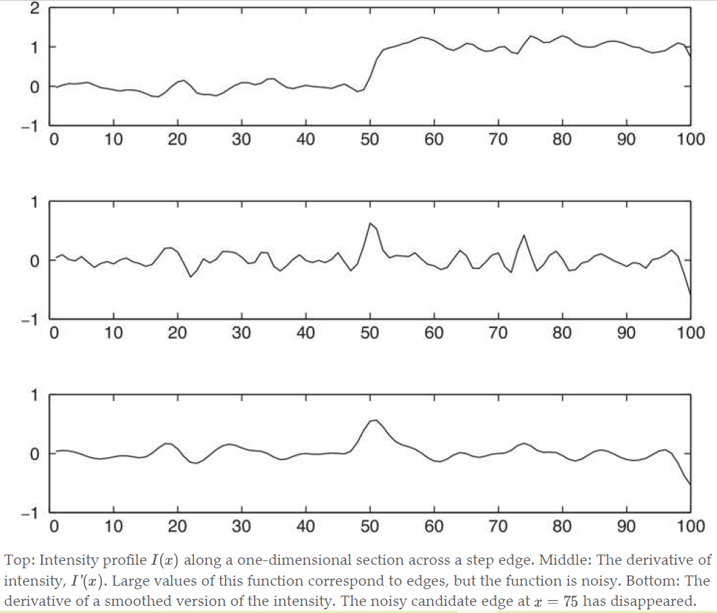
Edge detection

Slide 17
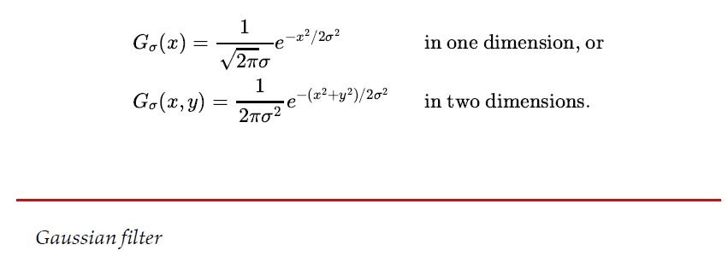
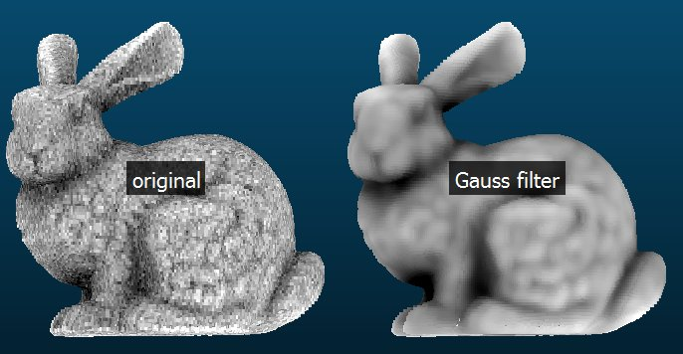
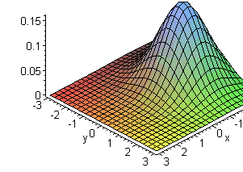
Gaussian filter

Slide 18
Edge detection

Slide 19
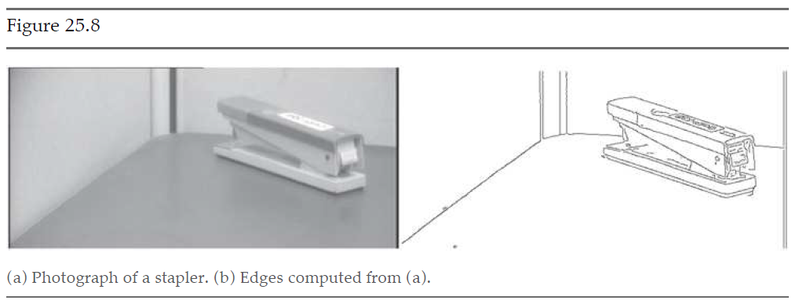
Edge detection

Slide 20
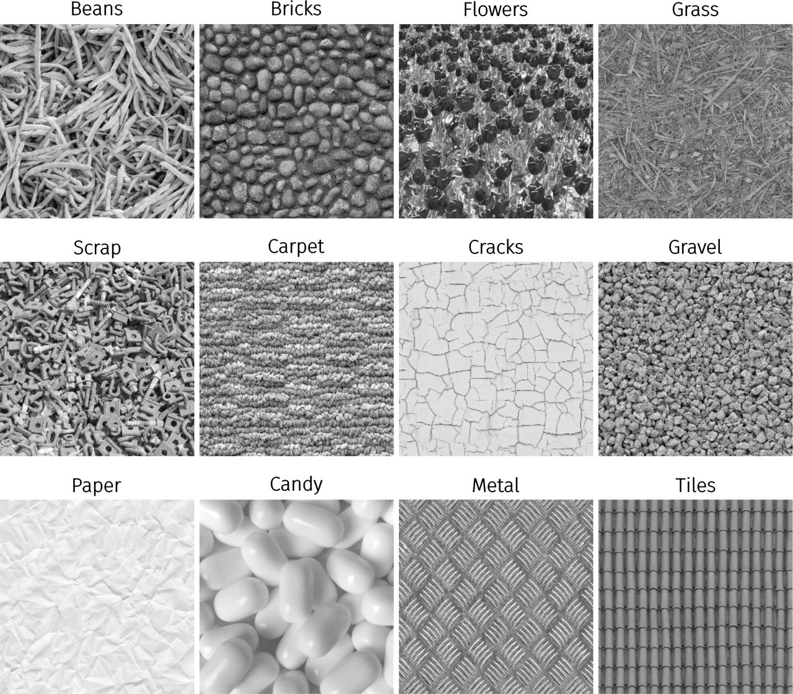
Textures

Slide 21
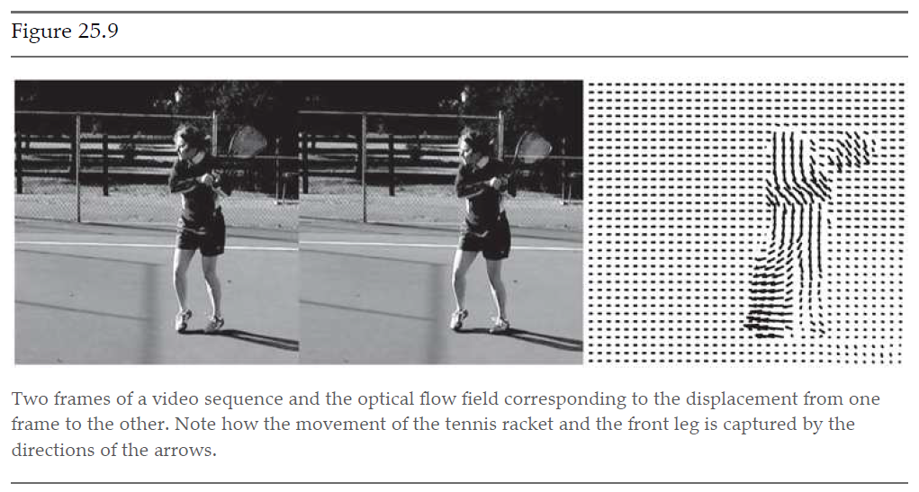
Optical flow

Slide 22
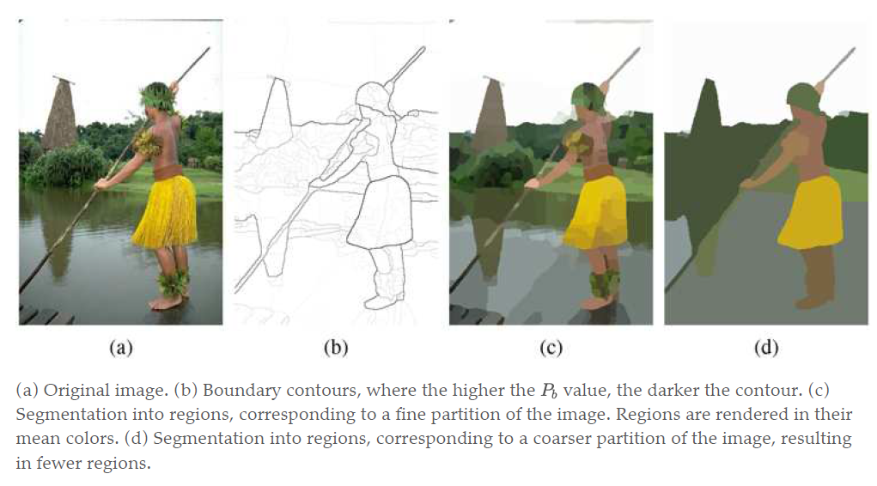
Segmentation of images
process of breaking an image into groups of similar pixels

Slide 23
How to segment images?
Detecting boundary curves
Clustering pixels having similar brightness
Model as graph partitioning problem
Minimize sum of weights across the groups
Maximize sum of weights within the groups
Super-pixels approach

Slide 24
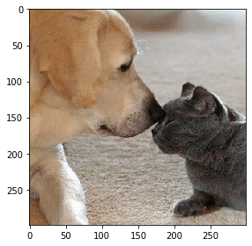
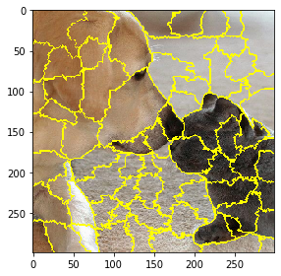
Segmentation of images (application)

Slide 25
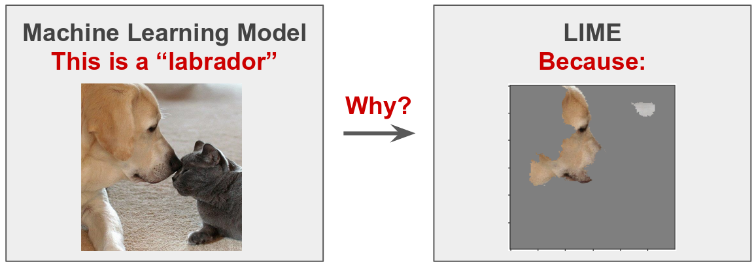
Segmentation of images (application)

Slide 26
Image classification

Slide 27
Factors affecting classification
Lighting
Foreshortening
Aspect
Occlusion (partially visible)
Deformation

Slide 28
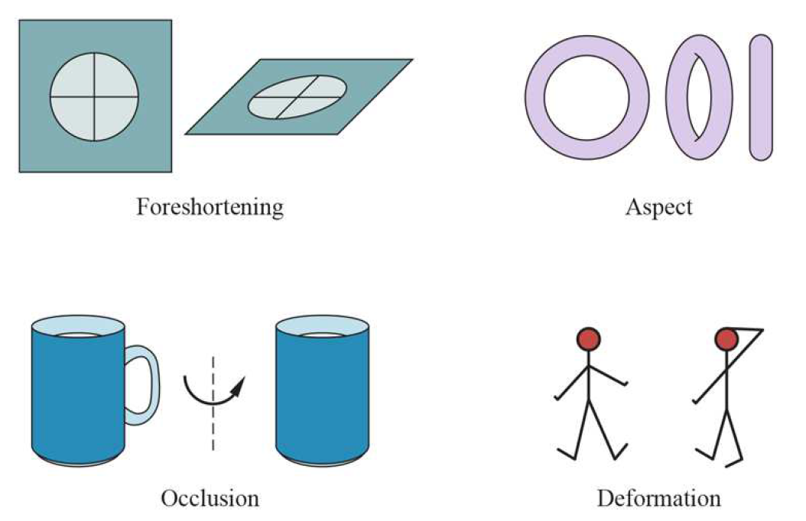

Slide 29
Classification with CNNs
ImageNet - 14 M training samples - 30,000 categories
Beating humans by achieving 98% in top 5 classes
Primary reason: Self created features or end-to-end learning
Amazing talk by Jay Yagnik (VP-Google AI) at Google symposium

Slide 30
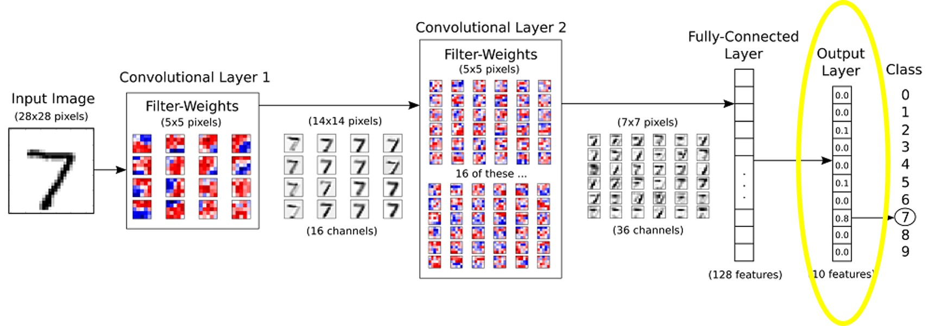
Why CNN work well? Local pattern detectors

Slide 31
Practical tricks to improve CNN
Dataset augmentation
While training
Increases dataset size
Create diverse dataset
While testing
Show deformed/partial images, take a mode as final output

Slide 32
Object detection

Slide 33
General approach
Decide a window shape
Convolve image with this window
For each window, do classification with CNN
Prioritize windows to look at
Find best window from overlapping windows
Report exact location of an object

Slide 34
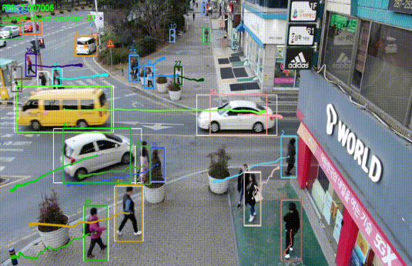
Window size - RPN (Regional Proposal Network)

Slide 35
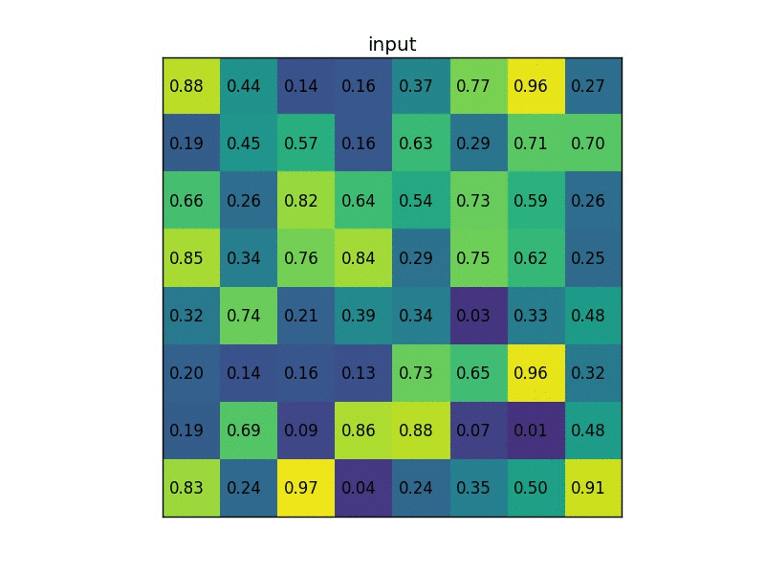
CNN need a fix size input - ROI pooling

Slide 36
Which window to report as output?
Take all the windows above threshold
Report with maximum value

Slide 37
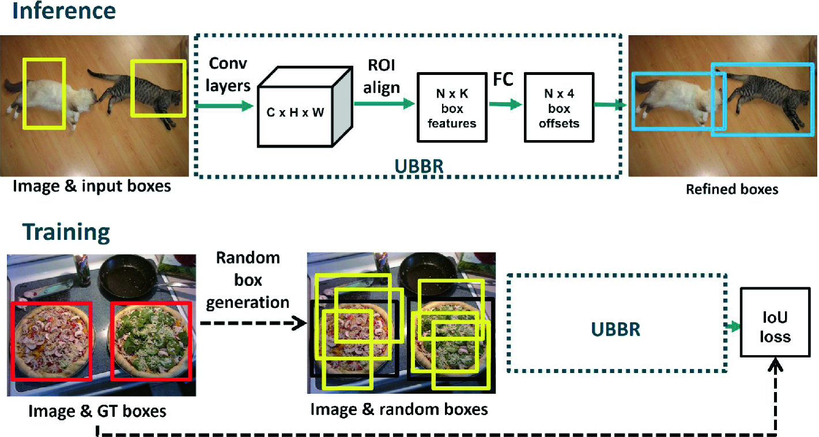
How to report exact location? - bounding box regression

Slide 38
The 3D world

Slide 39
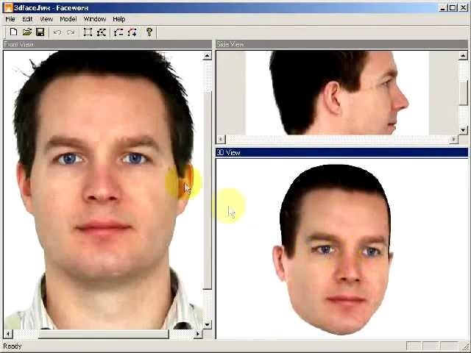
3D image from multiple 2D images

Slide 40
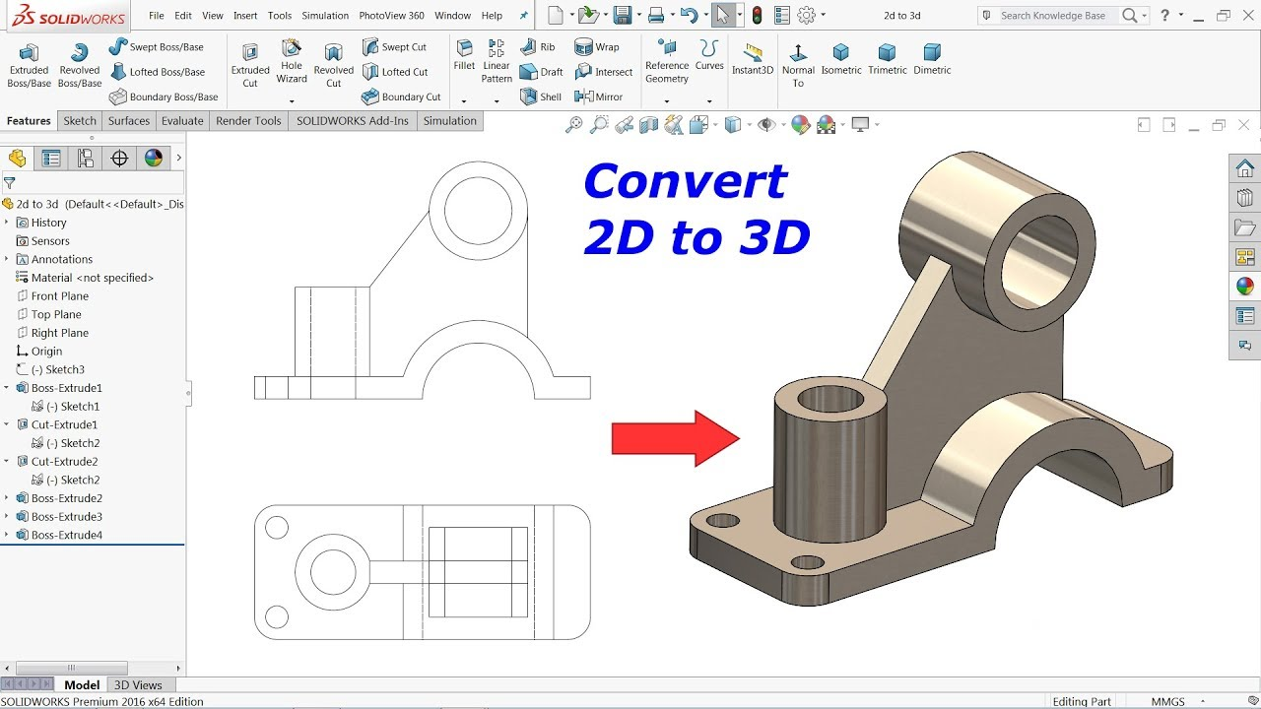
3D image from multiple 2D images

Slide 41
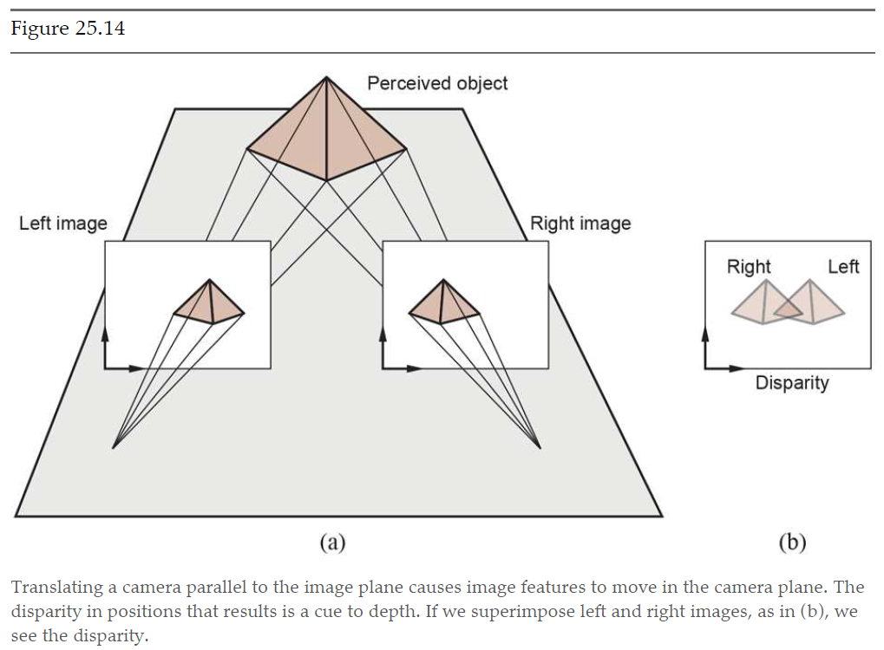
Binocular stereopsis
Moving camera

Slide 42
3D cues from single view
Easy for known objects
Pose detection
Surgery
Robotic arm picking an object

Slide 43
Applications

Slide 44
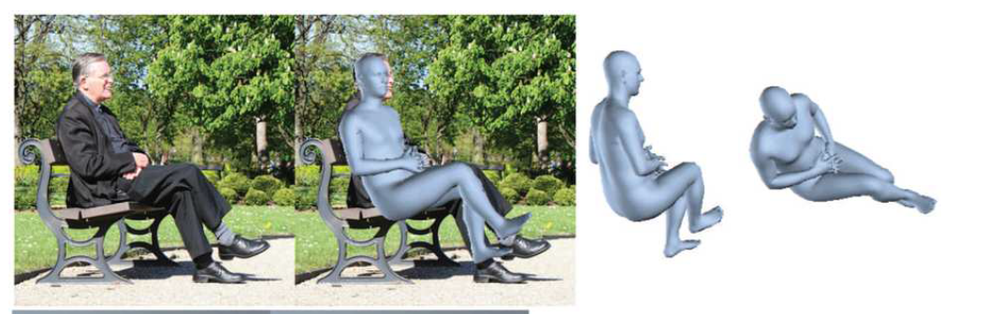
Reconstructing humans (SOTA is very accurate)
Kanazawa, A., Black, M., Jacobs, D., and Malik, J. (2018a). End-to-end recovery of human
shape and pose. In CVPR-18.

Slide 45
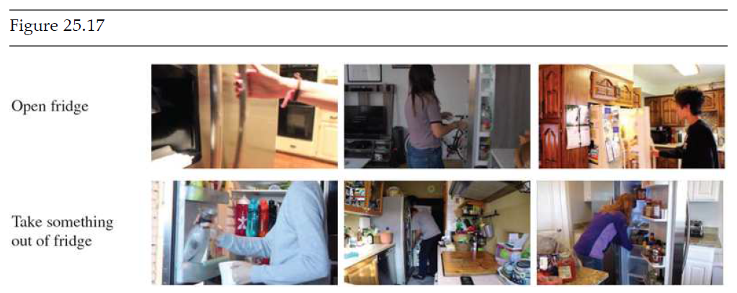
Classifying actions is a bit hard

Slide 46
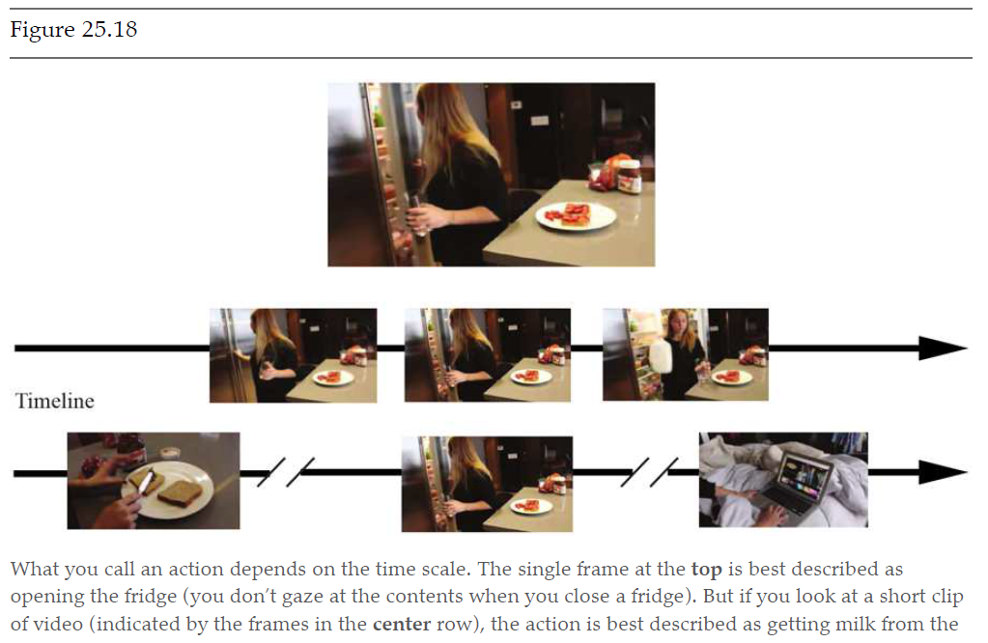
Classifying actions is a bit hard

Slide 47

Linking pictures with words (tagging)
Tags
Cat
street
Fish
Trash can
Maybe cat is pulling out a fish from a public trash can

Slide 48
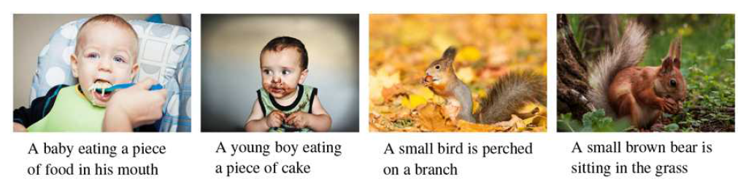
Captioning the images
Coupled CNN with RNN or transformers

Slide 49
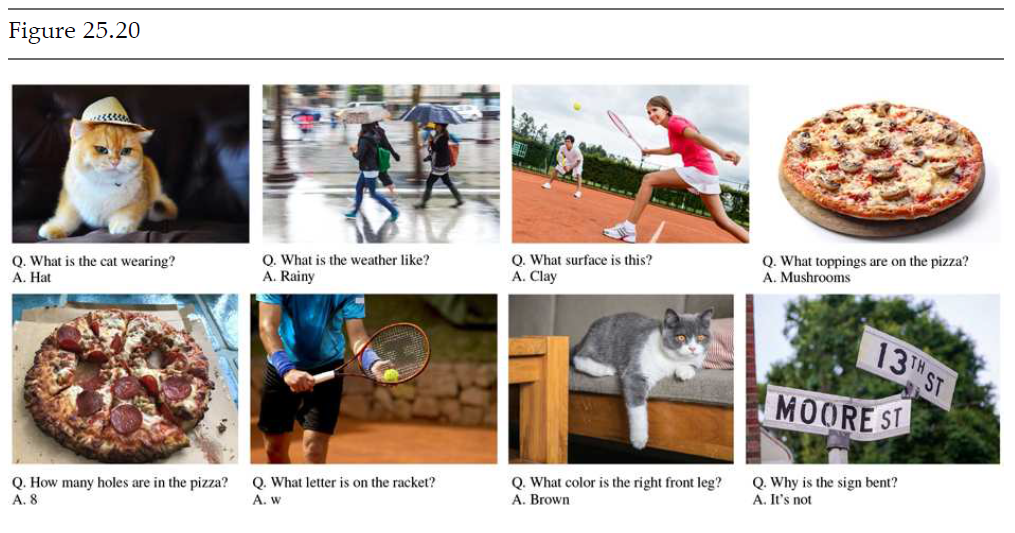
Visual Question-Answer (VQA) system

Slide 50
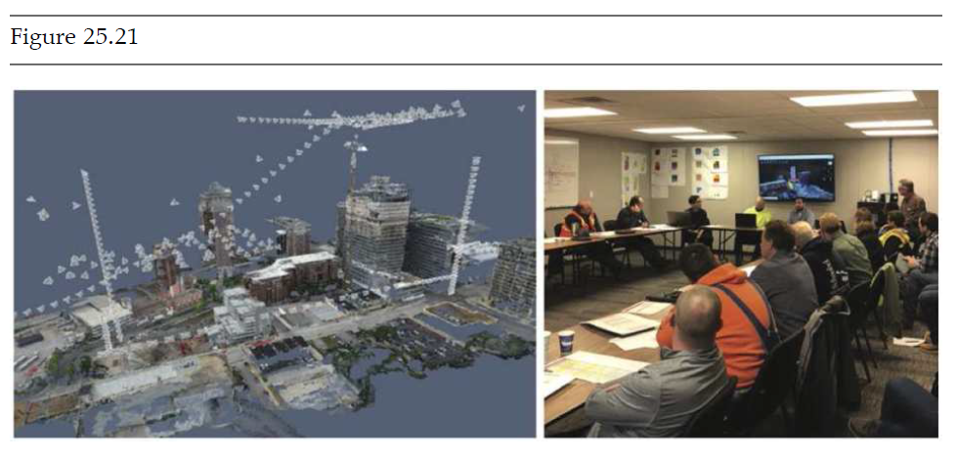
Reconstruction from many views

Slide 51
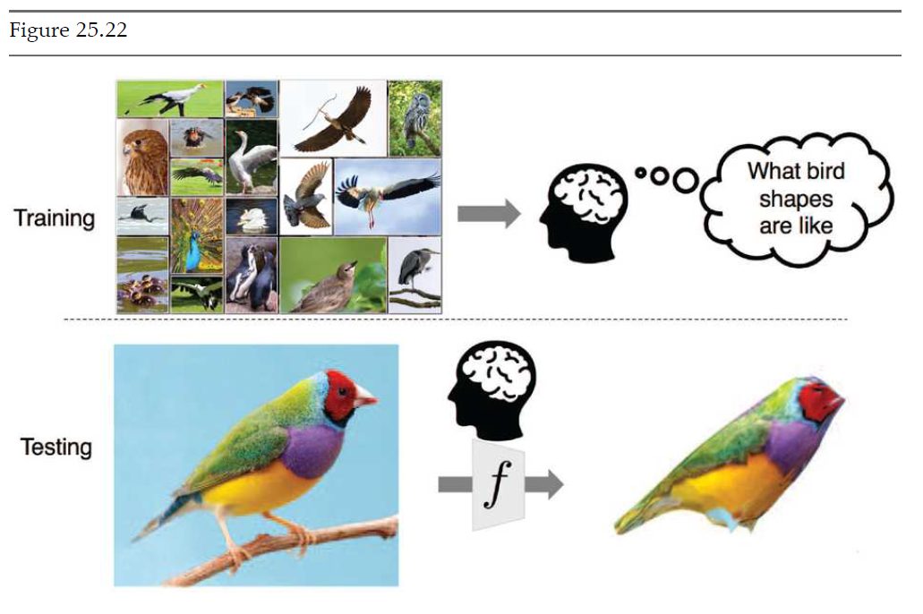
Reconstruction from single view

Slide 52
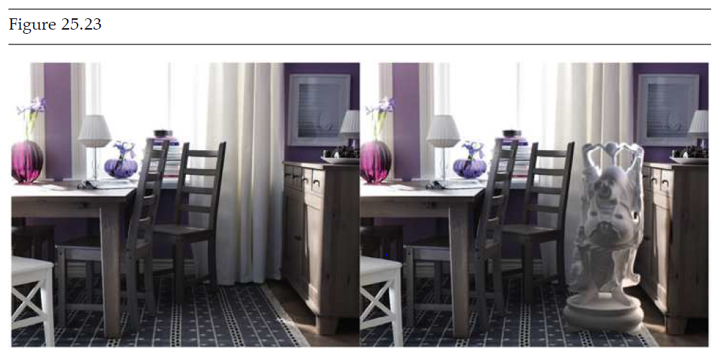
Making pictures

Slide 53
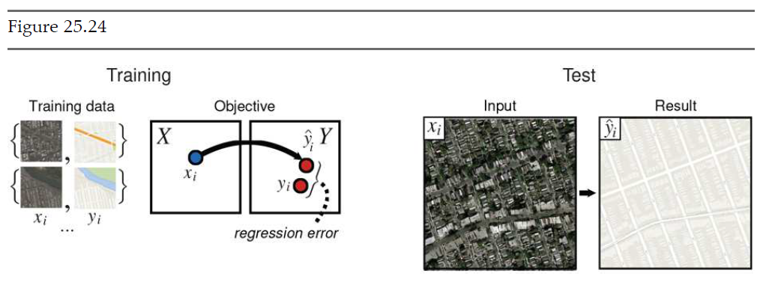
From aerial views to maps

Slide 54
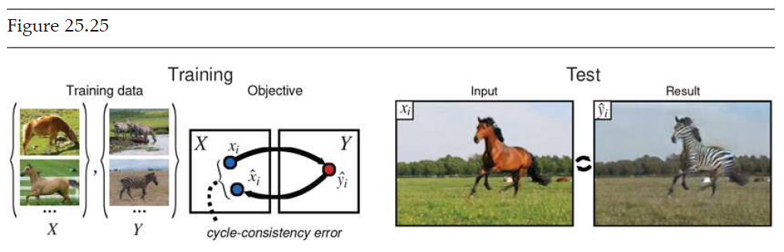
Image transformation

Slide 55
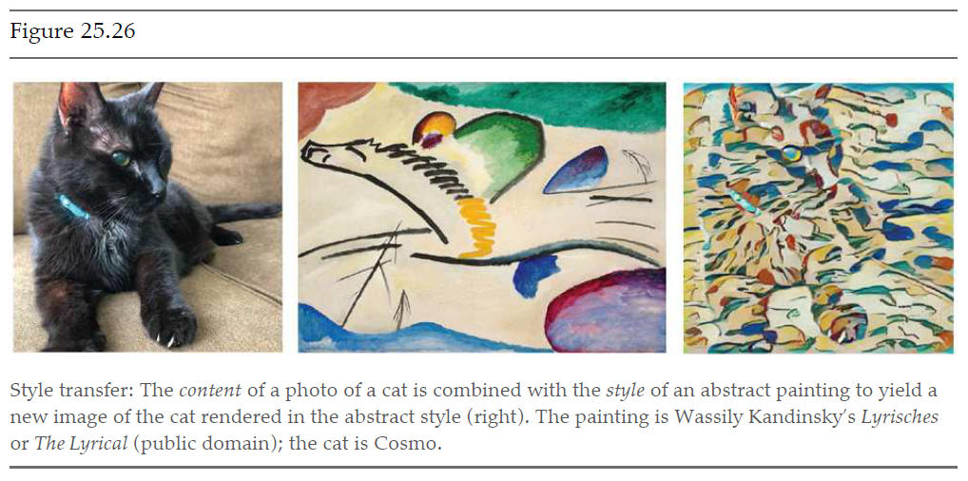
Style Transfer

Slide 56
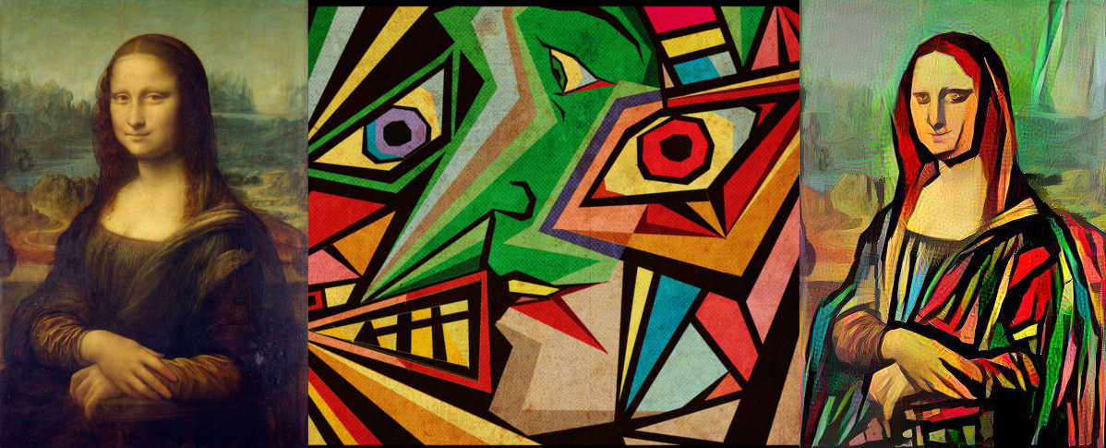
Style Transfer

Slide 57
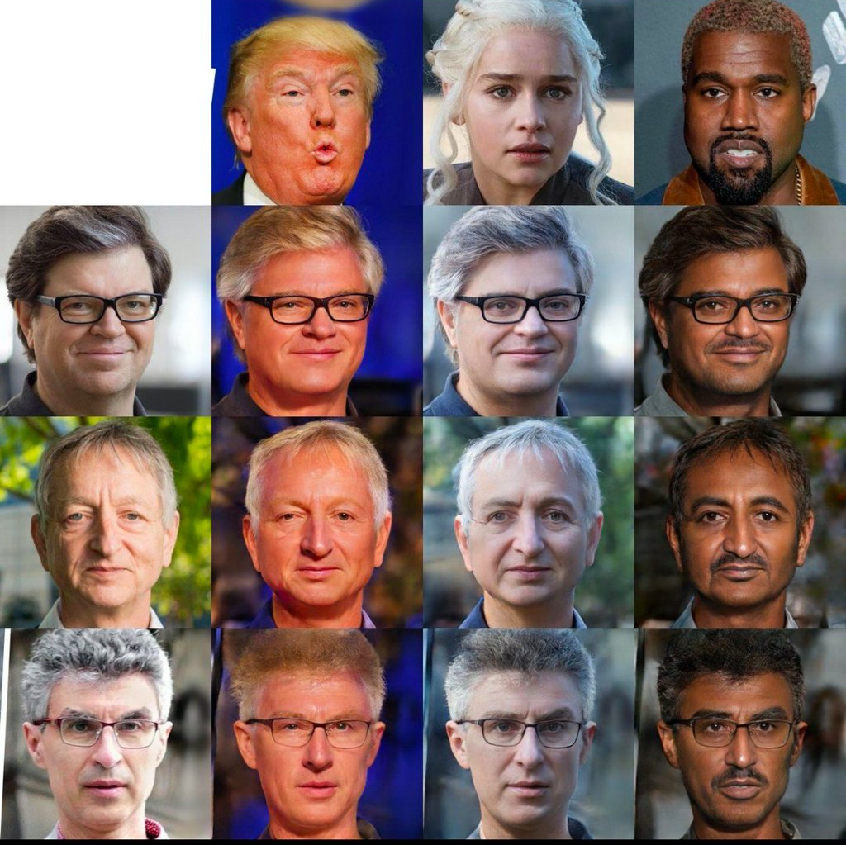
Style Transfer
https://twitter.com/pytorch_warrior/status/1240179868681158656

Slide 58
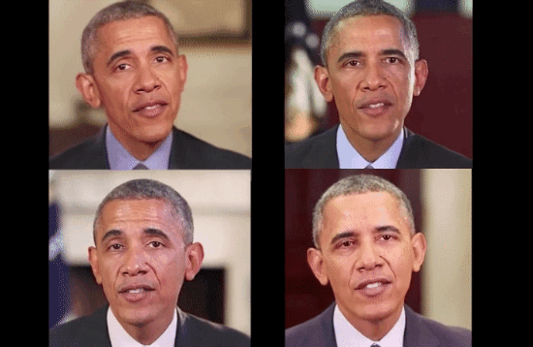
Deepfake

Slide 59
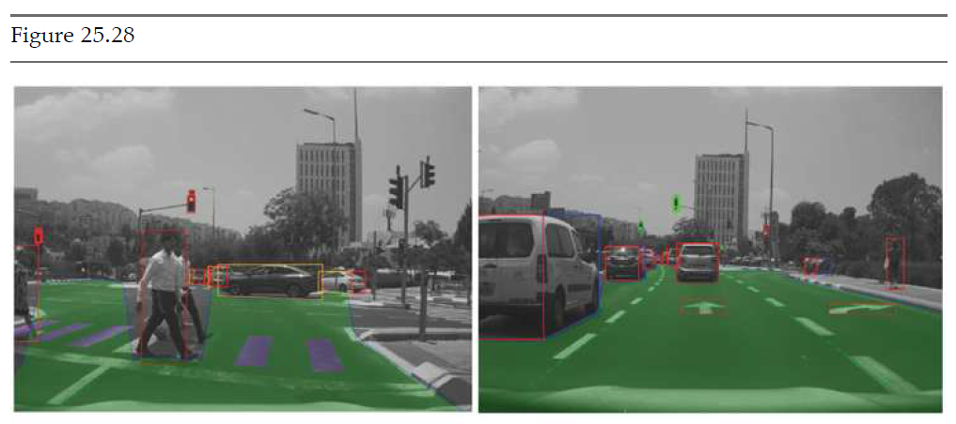
Controlling movement with vision

Slide 60
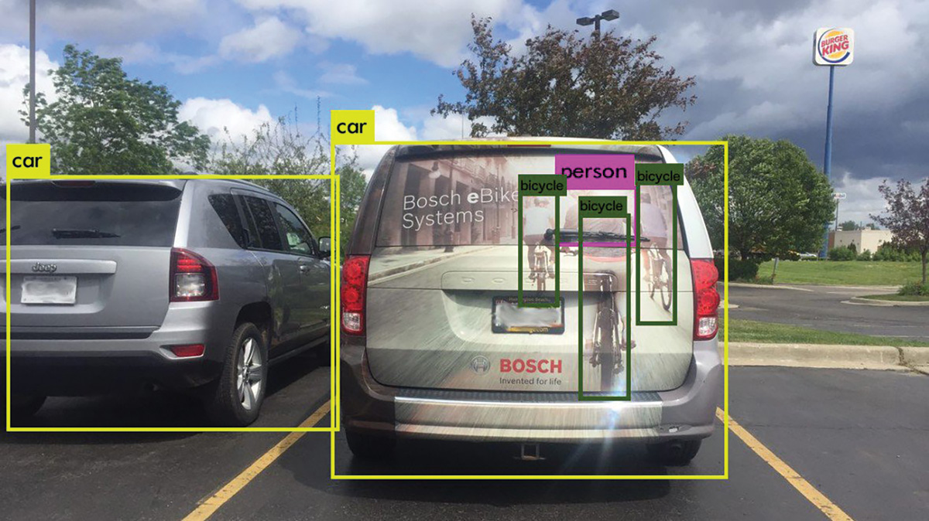
Controlling movement with vision (bad idea?)

Slide 61
The End

